Slide 1
Decision Tree
Shreenidhi Sudhakar

Slide 2
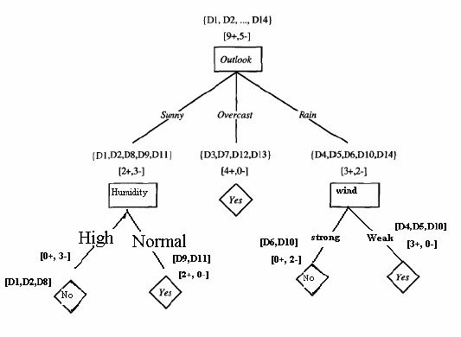
Decision Tree
Decision Tree is implemented using ID3 algorithm
ID3 is also known as Greedy Search Algorithm
Attributes with highest information gain is placed at top of the tree
Decision trees are easy to read and hence are preferred when number of data samples is less

Slide 3

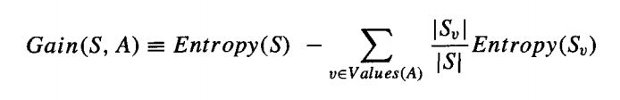
Cross Entropy
i = Number of class labels
S_{v} = Entropy of classes having column value v

Slide 4
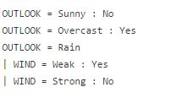

Results: Tennis
Tree Structure
Accuracy
Pre-Pruning
Test: 33.33
Validation: 100
Post-Pruning
Test: 33.33
Validation: 100
Rule Set
Pre – Pruning
Post – Pruning

Slide 5
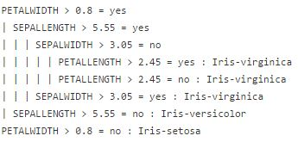
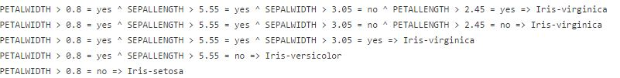
Results: Iris
Tree Structure
Rule Set
Accuracy
Validation: 83.33
Test: 66.66

Slide 6
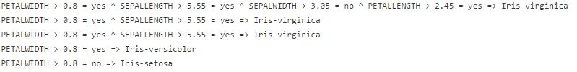
Results: Iris
Post Pruning
Rule Set
Accuracy
Validation: 100
Test: 96.66

Slide 7
Real Time Application
Text Processing
Medical text classification
Power Station
Security assessment
Stability prediction
Medical Research
Cardiology, Diagnosis, Psychiatry

Slide 8
Thank You
Check Out : shreenidhi.azurewebsites.net

